Slide 1

Projects & Algos
Solo Project
DEV Kacy Gilbert
APP Closet

Slide 2
Topics to Cover
Overview of the app. What is the intention to build and possible uses?
Functionality of the App. What’s under the hood? And why’s it there?
Challenges. What was difficult?
Challenges overcome…
Challenges still being worked…
Complete Wins. What went right?
Expected Wins
Unexpected Wins
CRUD review
Summary

Slide 3
Overview of the App
Title: Closet App
Goal of the Project: The goal is to help with the organization of one’s wardrobe, which will be extremely helpful in my household of three daughters! They take way too much time in my opinion deciding what to wear and when to wear it, the hope for this app is that it allows us to save time and make outfit planning more efficient
Stack & gitHub Link ➔ MERN ➔ https://github.com/Remontz/Closet

Slide 4
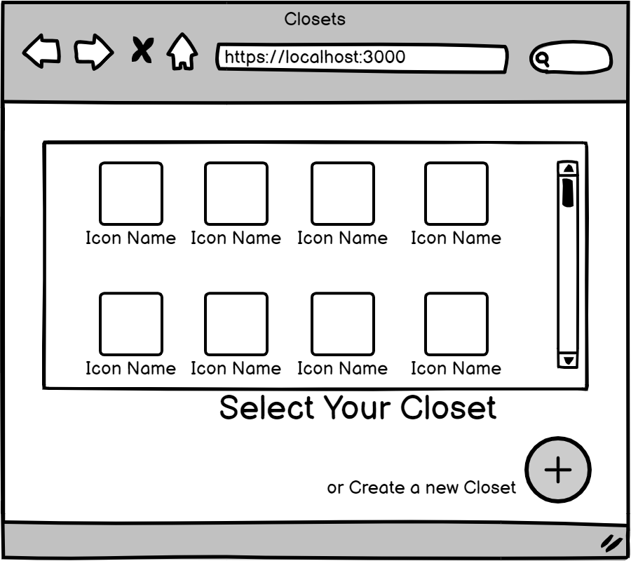
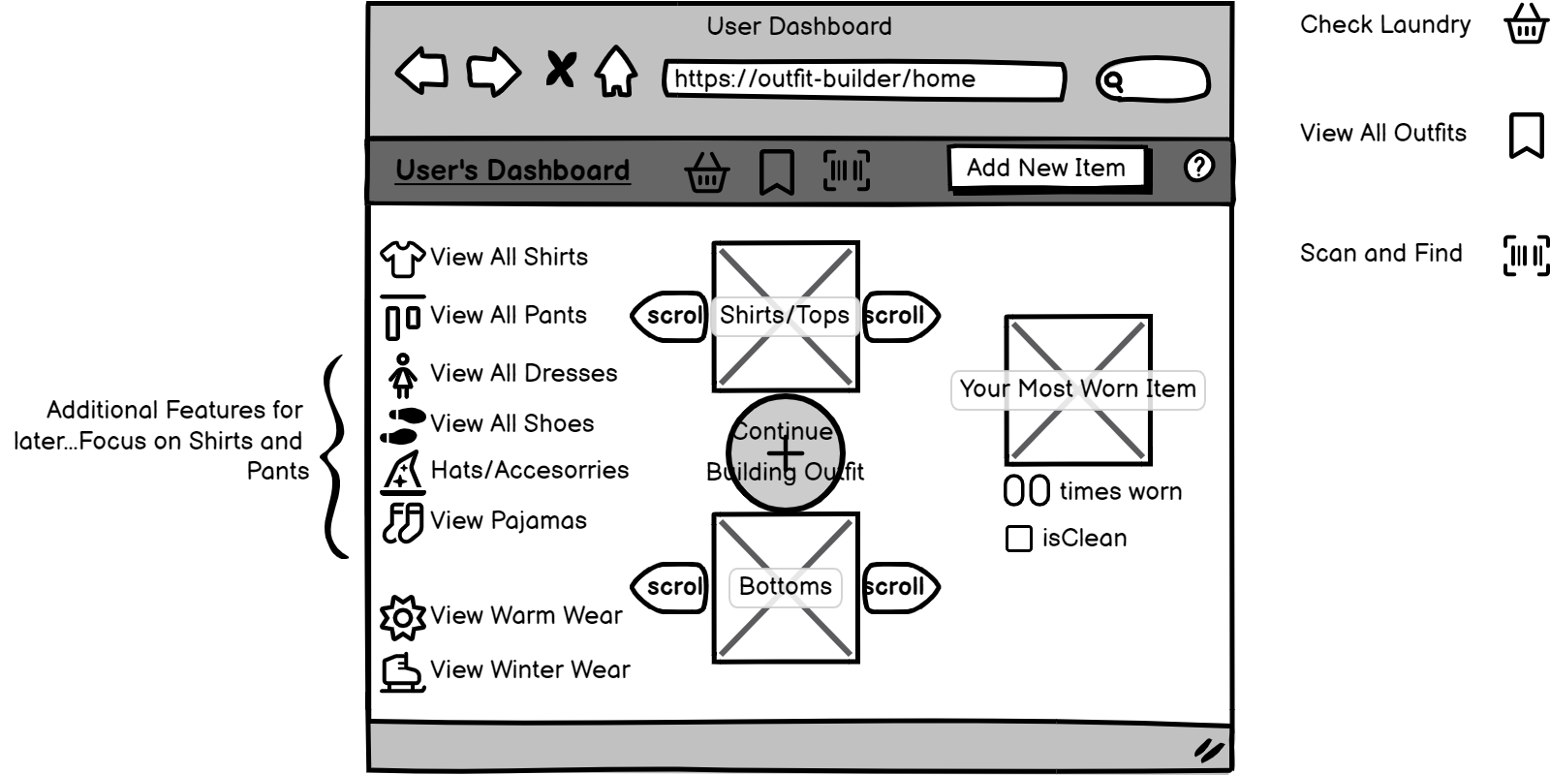
Wireframe(s)

Slide 5
Functions within the app
List of functional components:
ClosetDashboard - The closet Dashboard is a home page of sorts, displaying items within the closet and links to all other components of the App. It has the following features/functions:
Display All Shirts & Display All Pants
Closet Item(image) Scrolling
CreateCloset - This components allows a user to create a new closet.
DisplayAllClosets - A splash page that allows for selecting the closet you’d like to view or edit
DisplayLaundry - The laundry page isn’t CRUD credible; however it is vital to keeping the wardrobe organized and tracked. “No more searching for clothes that are in laundry, instead of preparing for the school day.”
Real time update of isWorn property of closet items with check bod
EditCloset - This page has presented the vast majority of challenges. Attempting to edit the closet objects shirts and pants has proven to be quite the personal adventure into additional learning and head scratching.

Slide 6
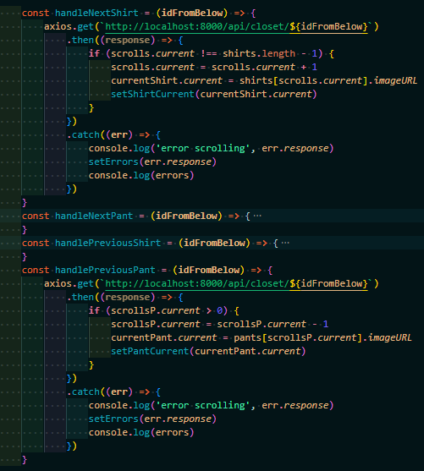
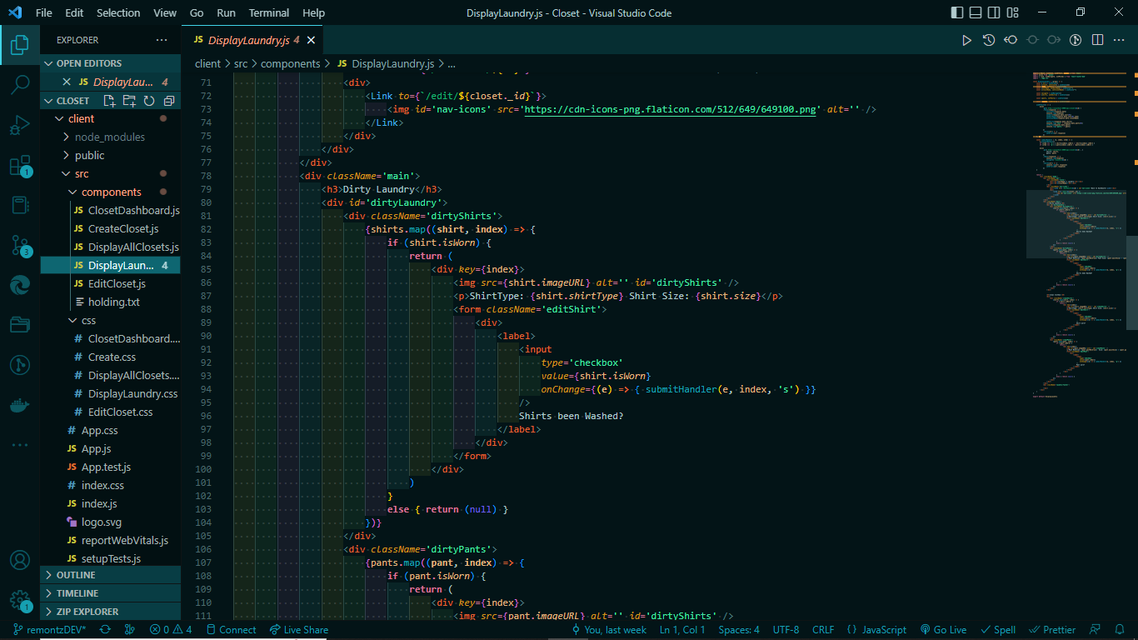
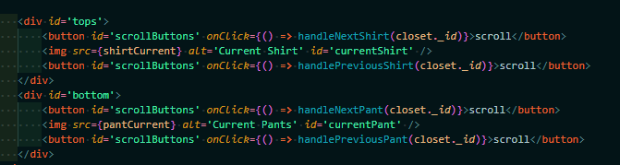
Challenges
Challenges Overcome ++
Within the ClosetDashboard.js component: Being able to scroll through individual items of clothing to build a preview of possible outfits with tops and bottoms.
Challenges Overcome ++
Updating Laundry live within the DisplayLaundry.js component

Slide 7
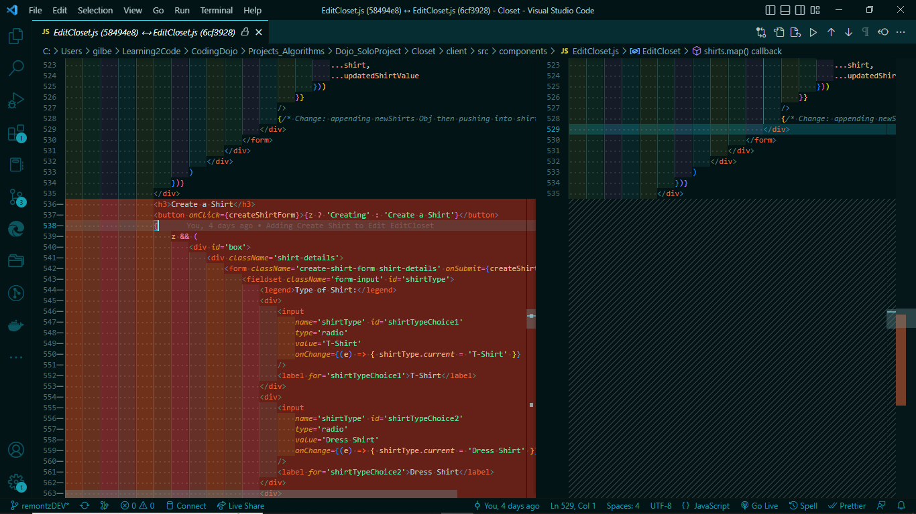
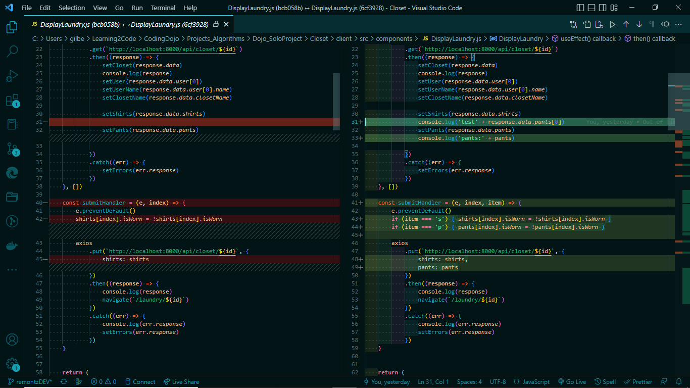
Challenges
Solutions still to come - -
Updating Items within Closet, EditCloset.js
Items that are input in the AddShirt form field are only temporary. Plan of Action to solve: Requires more study on use of useRef() in order to accomplish this task.
Solutions Still to Come - -
Updating Laundry live within the DisplayLaundry.js component
Larger Image on the Following Slide (8)
Larger Image on Later Slides (9)

Slide 8
Challenges -- Cont’d.
The Attempt was to produce a functioning ‘Create A Shirt’ Form Field after clicking the Create a Shirt button. The button successfully produced the div upon click(s); however the input of the form is not updating the closet.shirts array properly. Further inspection is required to figure out how and where the data I need is not being accepted as a ‘shirt’ and not being persisted within the closet.

Slide 9
Challenges -- Cont’d.
There was a major time-management set back here when trying to implement this functionality. The shirts array within a specific users closet is not persisting the isWorn data provided by the submitHandler function shown in the image. Plan of Action is to review useRef/useState and apply to this components as needed.

Slide 10
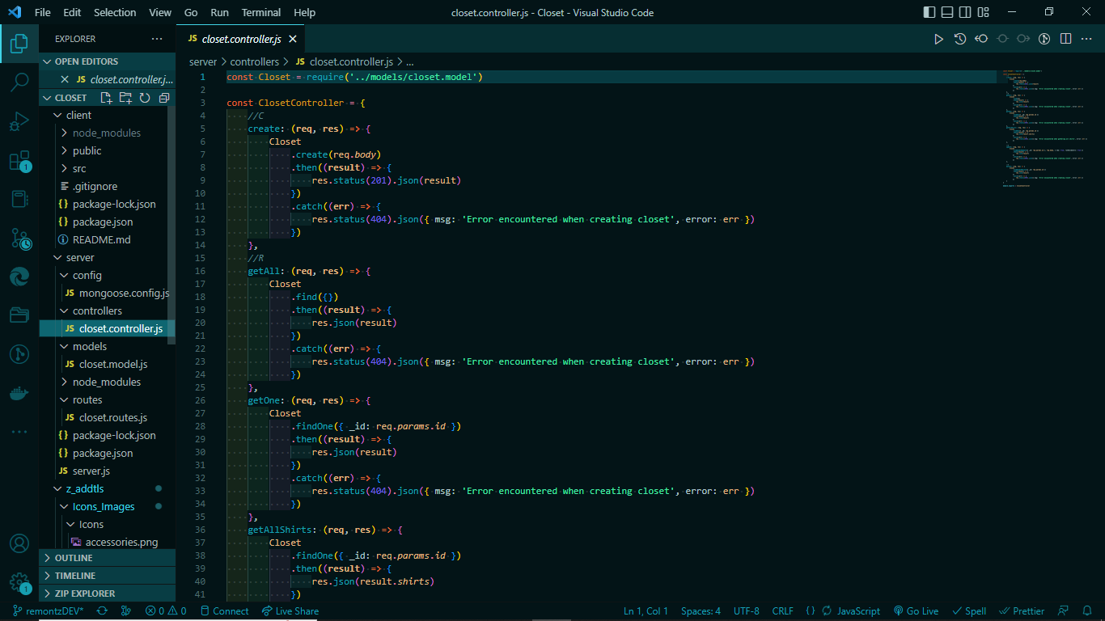
All-Around Wins
Expected comfort areas
Backend (server side)
Displaying All Closets
CRUD for Closets
Unexpected comfort areas
Unsurprisingly…There weren’t any areas that I felt were surprisingly comfortable. I either felt good about the process or it required some studying/spanning StackOverflow for answers.

Slide 11

Show me some CRUD!!!
So far the app is able to perform CRU operations upon the closet, however updating individual items, such as shirts, within each closet has proven to need more time investment than has currently been spent.

Slide 12
SUMMARY
In summary, the closet App is an app designed to help facilitate and organize a households’ wardrobes. Each user is able to create and maintain their own closets, and even view others closets within the household, without the ability to edit or delete unless they are the user associated with said closet.
The facet of building this Closet that has been the most challenging so far has been in the use of UseRef and/or useState within components in order to update the closet items: shirts or pants.
The piece(s) of the App that I am most proud of are the scrolling efects of the dashboard and the button that hides or shows the create shirt/pant form fields.

Slide 13
End
Thank you for viewing!

